Slide 1
Full-Stack Development
Overview of Front-End and Back-End Development | Web Hosting | Server-Side Programming | Databases | Client-Side Technologies
Notes:
Welcome to our lecture on full-stack we development. In this lecture we will go through overview of front end and back-end development, web hosting, server-side programming, databases, and client-side technologies. Let’s start the video lecture.

Slide 2
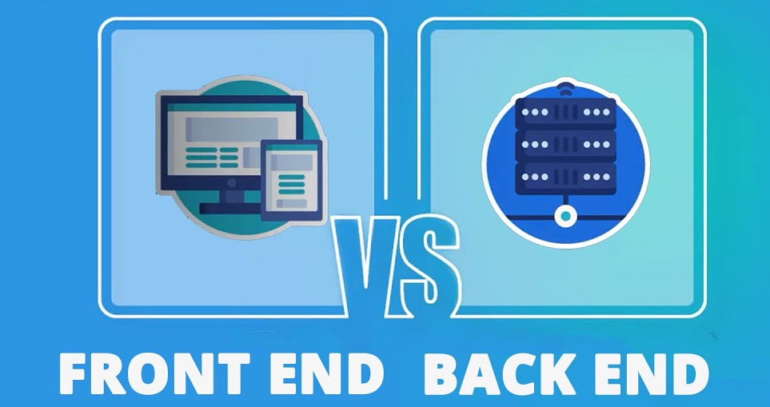
Overview of Front-End and Back-End
Front-end (Client-side): Runs in the web browser using HTML, CSS, and JavaScript to create interactive user interfaces.
Back-end (Server-side): Runs on the web server using technologies like PHP, Python, Node.js, and databases to process requests and store data.
Example: Amazon uses back-end for product storage and front-end for the search and purchase interface.
Notes:
Transitioning from the basics of web development, let's explore the overview of front-end and back-end. Front-end runs in the browser using HTML, CSS, and JavaScript for interactive interfaces. Back-end operates on the server using PHP, Python, and databases to process requests. For example, Amazon uses the back-end for product storage and the front-end for search and purchase.

Slide 3
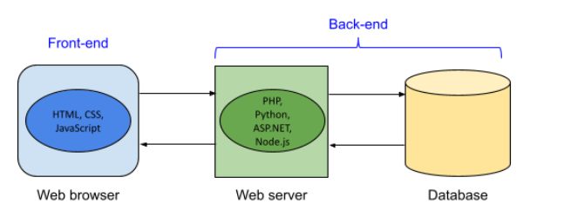
Front-End & Back-End Technologies
Notes:
Continuing from the overview, let's look at front-end and back-end technologies. The front-end uses HTML, CSS, and JavaScript to create the user interface in the browser. The back-end operates on the web server using languages like PHP, Python, ASP.NET, and Node.js. It interacts with the database to store and retrieve data, ensuring smooth communication between browser and server.

Slide 4
Web Hosting
Hosting Choices: Large companies host on their own servers; smaller ones use web hosting services.
Key Factors: Reliability (uptime and backups), Flexibility (scaling with VPS), Security (protection from hacks), and Price (varies by features).
Scalability: VPS and cloud services (e.g., AWS) allow quick scaling for high demand.
Cost vs. Control: Free or low-cost plans have limited features; dedicated hosting offers full control at a higher cost.
Notes:
Transitioning from technologies, let's discuss web hosting. Large companies host on their own servers, while smaller ones use web hosting services. Key factors include reliability, flexibility, security, and price. Scalability is achieved using VPS or cloud services. Cost versus control varies, with dedicated hosting offering full control at a higher cost.

Slide 5
Server-Side Programming
Server platform: Some web servers support certain languages and not others. Ex: IIS supports ASP.NET, and Apache supports PHP.
Tool support: Some tools are ideal for working with certain programming languages. Ex: PhpStorm is ideal for PHP development, and Visual Studio is ideal for ASP.NET.
Developer experience: JavaScript developers may choose Node.js instead of learning a new language like C#. Developers who are new to web development might already know Java or Python and prefer those languages.
Library support: Some languages may have pre-built libraries that support some web applications better than others.
Notes:
Building on web hosting, let's explore server-side programming. Server platforms support different languages like IIS for ASP.NET and Apache for PHP. Tool support varies, with PHP Storm for PHP and Visual Studio for ASP.NET. Developer experience influences language choice. Library support also impacts how well a language suits web applications.

Slide 6
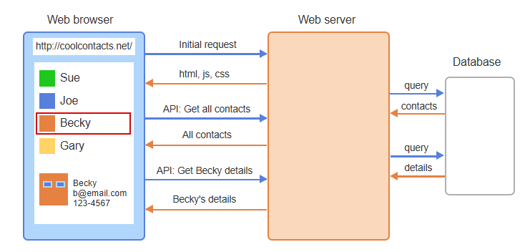
Example
Notes:
Building on server-side programming, let's look at an example of how web applications work. The browser makes an initial request, receiving HTML, CSS, and JavaScript from the web server. It then makes API requests to get contact details. The server queries the database and sends back the required data, ensuring seamless interaction between browser, server, and database.

Slide 7
Database
Relational Databases: Store data in tables using SQL (e.g., MySQL, PostgreSQL, Oracle, SQL Server).
NoSQL Databases: Use flexible data models and different query languages, gaining popularity for scalability.
Usage Trend: Relational databases are traditional, but NoSQL is preferred for dynamic and large-scale applications.
Notes:
Continuing from the example, let's discuss databases. Relational databases store data in tables using SQL, with examples like MySQL and PostgreSQL. NoSQL databases use flexible data models for scalability. While relational databases are traditional, NoSQL is gaining popularity for dynamic and large-scale applications due to its flexible structure.

Slide 8
Types of Non-Relational Databases
Document database: For storing documents in JSON format with many levels of nesting. Ex: MongoDB.
Key-value database: For storing values that are associated with unique keys. Ex: Redis.
Object database: For storing objects created in object-oriented programming languages. Ex: Caché.
Column database: For storing and processing large amounts of data using pointers that link to columns distributed over a cluster. Ex: HBase.
Graph database: For storing graph structures with nodes and edges. Ex: Neo4j.
Notes:
Building on databases, let's explore types of non-relational databases. Document databases store JSON data, like MongoDB. Key-value databases use unique keys, like Redis. Object databases store objects, like Caché. Column databases handle large data sets, like HBase. Graph databases store nodes and edges, like Neo4j, ideal for complex relationships and connections.

Slide 9
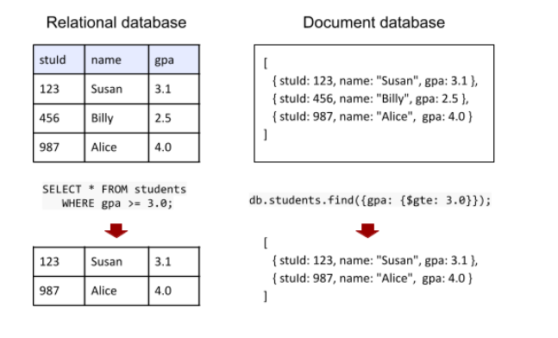
Example
Notes:
Continuing from non-relational databases, here's a comparison example. A relational database uses tables and SQL queries, like selecting students with a GPA above 3.0. A document database stores data in JSON format, using queries like find with conditions. Both achieve the same result but use different structures and query languages.

Slide 10
Client-Side Technologies
UI Development: Built using HTML, CSS, and JavaScript.
HTML/CSS Preprocessors: Simplify coding with easier syntax (e.g., Haml, Sass).
UI Libraries: Provide ready-made widgets and DOM tools (e.g., jQuery UI, React, Vue.js).
CSS Frameworks: Help create responsive designs (e.g., Bootstrap, Foundation).
Notes:
Moving from databases to client-side technologies, UI development uses HTML, CSS, and JavaScript. HTML and CSS preprocessors like HAML and Sass simplify coding. UI libraries like jQuery UI, React, and Vue.js provide ready-made widgets. CSS frameworks like Bootstrap and Foundation help create responsive designs for a seamless user experience across devices.

Slide 11
JavaScript Development Tools
Compile-to-JavaScript Languages: Enhance JavaScript with extra features (e.g., TypeScript, CoffeeScript).
JavaScript Frameworks: Organize code and simplify tasks (e.g., AngularJS, Backbone, Ember).
Notes:
Continuing with client-side technologies, let's look at JavaScript development tools. Compile-to-JavaScript languages like TypeScript and Coffee Script add features like type safety. JavaScript frameworks like AngularJS, Backbone, and Ember organize code and simplify complex tasks, making development faster and more efficient.

Slide 12
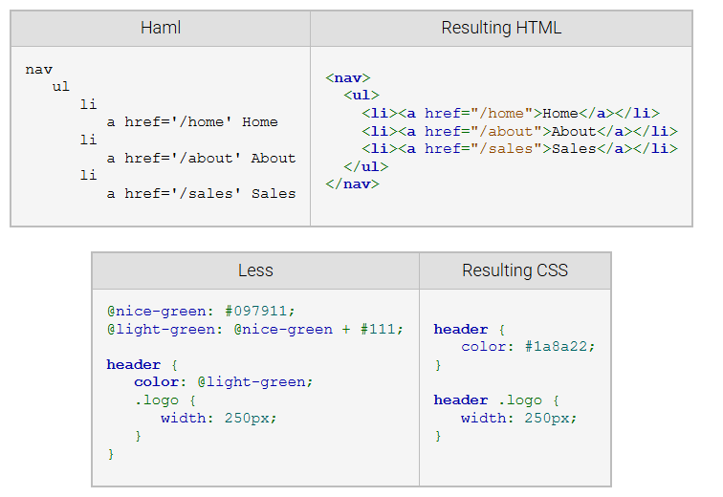
Example
Notes:
Continuing with JavaScript tools, here's an example of preprocessors. HAML is a cleaner syntax for writing HTML, converting to standard HTML tags. Less is a CSS preprocessor allowing variables and nesting, which compiles to regular CSS. Both tools simplify coding, making the development process faster and more maintainable by reducing repetitive code.

Slide 13
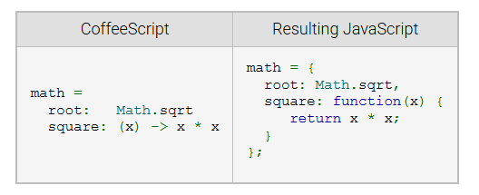
Example (Continue)
Notes:
Continuing with preprocessors, here's an example of Coffee Script. It provides a simpler, cleaner syntax for JavaScript. On the left, Coffee Script defines a math object with a square function using an arrow syntax. It compiles into regular JavaScript on the right. This reduces boilerplate code while maintaining functionality, making development more efficient. Thanks for watching the lecture.

